Slide 1

Pac-Man Quicksilver Ver
Bill Huang, Yang Zhou, Zhen Gao,
Jeff Zhou, Jianing Lou, Jerry Zhang, Zhengtong Liu

Slide 2

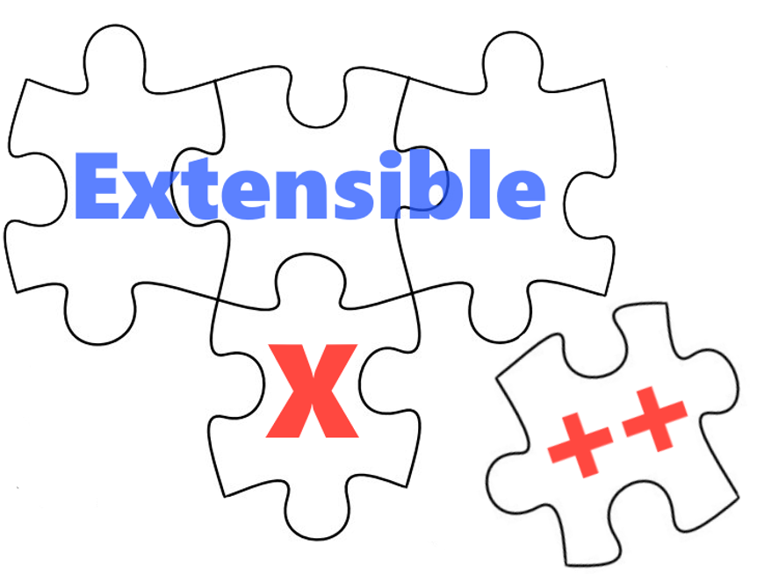
Design Problems
How to make use of our team name?
How to make the game extensible?

Slide 3
App Design

Slide 4
Board
Interface IPacmanBoard

Slide 5
Objects
Interface IObject
Class Ghost
Class Pacman
Abstract Class AConsumableObject
Class Dots
Class Fruit
Class Quicksilver Charm

Slide 6
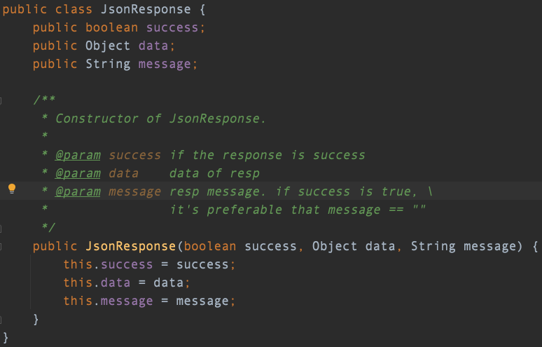
Json Response

Slide 7
Use case: Frontend
Starts the game
Gets the most up-to-date board
Resets the game
Change Pac-Man’s direction
Set number of ghosts
Initialize the game board

Slide 8
Use cases: Backend
Return current board state to frontend
Reset the board state to default
Start the game by invoking the board to updates
Set number of ghosts on a board
Change direction of Pac-Man
Initialize the game board and create necessary objects

Slide 9




Design Patterns
1. Strategy Design Pattern
2.Command Design Pattern
3. Factory Design Pattern
4. Singleton Design Pattern

Slide 10
Strategy Design Pattern

Slide 11
Command Design Pattern

Slide 12
3. Factory Design Pattern

Slide 13
4.Singleton Design Pattern

Slide 14
Demo

Slide 15
Q&A

Slide 16
Thanks for listening！

